Slide 1
HW#2 Review
Wen-Yen Hsu
Dept Electrical Engineering
Chang Gung University, Taiwan

Slide 2
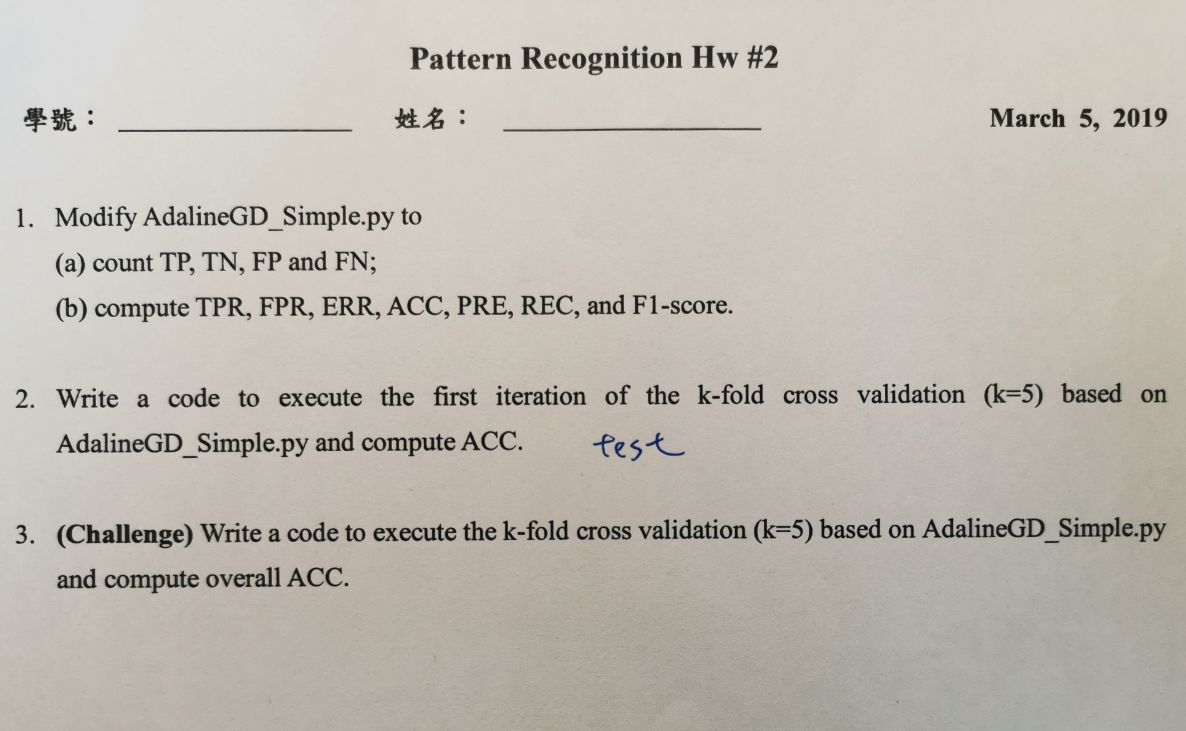
Exercise

Slide 3
TP, TN, FP, FN
def decision_measure(prediction, label, method='for_if'):
num_tp = 0
num_tn = 0
num_fp = 0
num_fn = 0
if method == 'for_if':
...
if method == 'mat_operat':
...
acc = (num_tp+num_tn)/(num_tp+num_tn+num_fp+num_fn)
# pre = num_tp/(num_tp+num_fp)
# ...
return num_tp, num_tn, num_fp, num_fn, acc

Slide 4
method == 'for_if'
if method == 'for_if':
for i in range(label.shape[0]):
if label[i] == 1:
if prediction[i] == 1:
num_tp = num_tp + 1
if prediction[i] == -1:
num_fn = num_fn + 1
if label[i] == -1:
if prediction[i] == 1:
num_fp = num_fp + 1
if prediction[i] == -1:
num_tn = num_tn + 1

Slide 5
method == 'mat_operat'
if method == 'mat_operat':
comparison = np.concatenate((label.reshape(label.shape[0], 1), prediction.reshape(label.shape[0], 1)), axis =1)
variety = np.array([[1], [2]])
result = np.dot(comparison, variety)
num_tp = label.shape[0] - np.count_nonzero(result-3)
num_tn = label.shape[0] - np.count_nonzero(result+3)
num_fp = label.shape[0] - np.count_nonzero(result-1)
num_fn = label.shape[0] - np.count_nonzero(result+1)

Slide 6
Usage
ada1 = AdalineGD(n_iter=13, eta=0.0001)
ada1.fit(X, y)
y_hat = ada1.predict(X)
# print(y)
# print(y_hat)
#Q1
tp, tn, fp, fn, acc = decision_measure(y_hat, y, method='for_if')
print('TP=', tp)
print('FN=', fn)
print('TN=', tn)
print('FP=', fp)
print('ACC=', acc)
print('\n')

Slide 7
Confusion Matrix (sklearn)
from sklearn.metrics import confusion_matrix
cmtn, cmfp, cmfn, cmtp = confusion_matrix(y_true=y, y_pred=y_hat).ravel()
print('confmat TN FP FN TP =', cmtn, cmfp, cmfn, cmtp)
print('\n')

Slide 8
K-fold cross-validation
def k_fold_CV(X, y, num_iter, time_kfCV):
order = np.arange(y.shape[0])
half_test_len = int(y.shape[0]/time_kfCV/2)
pre_test = order[num_iter*half_test_len : (num_iter+1)*half_test_len]
post_test = order[50+num_iter*half_test_len : 50+(num_iter+1)*half_test_len]
test_ord = np.concatenate((pre_test, post_test))
# print(test_ord)
train_ord = np.delete(order, [test_ord])
# print(train_ord)
return train_ord, test_ord

Slide 9
Usage
time_kfCV = 5
for kf_iter in range(time_kfCV):
print('K=', kf_iter+1)
train_fold_order, test_fold_order = k_fold_CV(X, y, kf_iter, time_kfCV)
X_train = X[train_fold_order]
y_train = y[train_fold_order]
X_test = X[test_fold_order]
y_test = y[test_fold_order]
ada2 = AdalineGD(n_iter=16, eta=0.0001)
ada2.fit(X_train, y_train)
y_hat_test = ada2.predict(X_test)
tp, tn, fp, fn, acc = decision_measure(y_hat_test, y_test, method='mat_operat')
print('TP=', tp)
print('FN=', fn)
print('TN=', tn)
print('FP=', fp)
print('ACC=', acc)

